Slide 1
Second tutorial after midterm result release

Slide 2
Stand up and do something
That’s appropriate

Slide 3
Tutorial 08
Xiao Liang | yuxiao@comp.nus.edu.sg
https://github.com/yxliang01/cs1010-fun-stuff
Adapted from Evan Tay’s Slide

Slide 4
Today’s plan
Unit 20: C Pre-processor
Problem Set 20.1, 20.2
Unit 21: Assert
Problem Set 21.1
Unit 22: Efficiency
Problem Set 22.1, 22.2

Slide 5
UNIT 20 C PRE-PROCESSOR
Recap. PS 20.1. PS 20.2

Slide 6
Recap
Preprocessor directive
A directive which starts with #
To #include a file or,
To #define a macro
Notes:
When the pre-processor encounters a directive, it reads the file specified and writes it to where the line #include occurs.
Any C preprocessor directive in the included file is recursively processed.

Slide 7
Recap - #include
#include <stdbool.h>
#include “cs1010.h”

Slide 8
Recap - #define macro
#define NAME EXPRESSION
Use it to define macros which are repeatedly used in code.
Whenever you use NAME in your code, it will be replaced with EXPRESSION
Notes:
Why not CTRL + F to replace a constant? Think about what if you use the constant 21 to represent an age limit and also a date in your code? In this case if you want to change one but not the other, for example age limit, you will have to step through every 21 found and decide whether to replace.
Why not use a variable? Variables can be changed and there is no guarantee it won’t be modified.

Slide 9
Recap - #define macro
#define SQUARE(x) x*x #define PI 3.1415926
int main() {
double radius = 4.0; cs1010_print_double(PI*SQUARE(radius));
}
Notes:
A block of code that is given an identifying name and is substituted and expanded during pre-processing.

Slide 10
Recap - #define macro
#define SQUARE(x) x*x #define PI 3.1415926
int main() {
double radius = 4.0; cs1010_print_double(3.1415926*radius*radius);
}

Slide 11
Recap – Macro warnings
Given:
#define SQUARE(x) x*x
SQUARE(radius + 2) evaluates to:
radius + 2*radius + 2

Slide 12
Recap – Macro warnings
Given:
#define SQUARE(x) ((x)*(x))
SQUARE(radius + 2) evaluates to:
((radius + 2)*(radius + 2))

Slide 13
ENDING NOTE
ALWAYS USE UPPERCASE WHEN #define CONSTANTS and MACROS

Slide 14
UNIT 20 C PRE-PROCESSOR
Recap. PS 20.1. PS 20.2

Slide 15
Problem Set 20.1 a)
#define MIN(a,b) a < b ? a : b
long i = MIN(10, 20); long j = MIN(10, 20) + 1;
What are the values of i and j?

Slide 16
Problem Set 20.1 a)
#define MIN(a,b) a < b ? a : b
long i = MIN(10, 20); long j = MIN(10, 20) + 1;
What are the values of i and j?
i = 10 < 20 ? 10 : 20 = 10
j = 10 < 20 ? 10 : 20 + 1
j = 10 < 20 ? 10 : 21 = 10

Slide 17
Problem Set 20.1 a)
#define MIN(a,b) (a < b ? a : b)
long i = MIN(10, 20); long j = MIN(10, 20) + 1;
What are the values of i and j?
i = 10 < 20 ? 10 : 20 = 10
j = (10 < 20 ? 10 : 20) + 1
j = 10 + 1 = 11

Slide 18
Problem Set 20.1 b)
#define MIN(a,b) a < b ? a : b
long i = 10; long j = 20;
long k = MIN(j, i++);
What are the values of i and k?
a) i = 11, k = 10 b) i = 11, k = 11
c) i = 12, k = 10 d) i = 12, k = 11

Slide 19
Problem Set 20.1 b)
#define MIN(a,b) a < b ? a : b
long i = 10; long j = 20;
long k = MIN(j, i++);
What are the values of i and k?
a) i = 11, k = 10 b) i = 11, k = 11
c) i = 12, k = 10 d) i = 12, k = 11
NANI?

Slide 20
Problem Set 20.1 b)
#define MIN(a,b) a < b ? a : b
long i = 10; long j = 20;
long k = MIN(j, i++);
k = 20 < i++ ? 20 : i++
k = 20 < 10++ ? 20 : i++
k = 20 < 10 ? 20 : 11++
k = 11; i = 12

Slide 21
UNIT 20 C PRE-PROCESSOR
Recap. PS 20.1. PS 20.2

Slide 22
Problem Set 20.2
Original solution
#define SWAP(T, x, y) {\ T temp;\ temp = x;\ x = y;\ y = temp;\ }
int main() {
long x = 3.0; long y = -1.0; SWAP(long, x, y);
}
Modified version
#define SWAP(T, x, y) T temp = x;\ x = y;\ y = temp;
int main() {
long x = 3.0; long y = -1.0; SWAP(long, x, y);
}
What could go wrong?

Slide 23
Problem Set 20.2 - Original
Original solution
#define SWAP(T, x, y) {\ T temp;\ temp = x;\ x = y;\ y = temp;\ }
int main() {
long x = 3.0; long y = -1.0; SWAP(long, x, y);
}
Becomes:
int main() {
long x = 3.0; long y = -1.0; { long temp; temp = x; x = y; y = temp;
};
}

Slide 24
Problem Set 20.2 - Original
Modified version
#define SWAP(T, x, y) T temp = x;\ x = y;\ y = temp;
int main() {
long x = 3.0; long y = -1.0; SWAP(long, x, y);
}
Becomes:
int main() {
long x = 3.0; long y = -1.0; long temp = x; x = y; y = temp;
}
What could go wrong?

Slide 25
Problem Set 20.2 - Original
Original becomes:
int main() {
long x = 3.0; long y = -1.0; { long temp; temp = x; x = y; y = temp;
};
}
Second solution becomes:
int main() {
long x = 3.0; long y = -1.0; long temp = x; x = y; y = temp;
}
What could go wrong?

Slide 26
Problem Set 20.2 - Original
Original becomes:
int main() {
long temp = 5.0; long x = 3.0; long y = -1.0; { long temp; temp = x; x = y; y = temp;
};
}
Second solution becomes:
int main() { long temp = 5.0; long x = 3.0; long y = -1.0; long temp = x; x = y; y = temp;
}
What could go wrong? This is what happens:
error: redefinition of ‘temp’

Slide 27
UNIT 21 C PRE-PROCESSOR
Recap. PS 21.1.

Slide 28
Recap
#include <stdio.h> #include <assert.h>
int main(){
char answer; printf(“Is CS1010 hard? Enter Y/N: ”); scanf(“%c”, &answer); assert(answer == ‘N’); }
If wrong answer is given: Assertion ‘answer == ‘Y’’ failed.

Slide 29
UNIT 21 C PRE-PROCESSOR
Recap. PS 21.1.

Slide 30
Problem Set 21.1
void foo(long x) { if (x % 2 == 0) { … } else { assert(x % 2 == 1); } }
Would the assert in Line 5 above ever fail?

Slide 31
Problem Set 21.1
void foo(long x) { if (x % 2 == 0) { … } else { assert(x % 2 == 1); } }
Would the assert in Line 5 above ever fail? Yes
Consider x = -1

Slide 32
Problem Set 21.2

Slide 33
Pop quiz
What does `cat` do?

Slide 34

Fun stuff

Slide 35
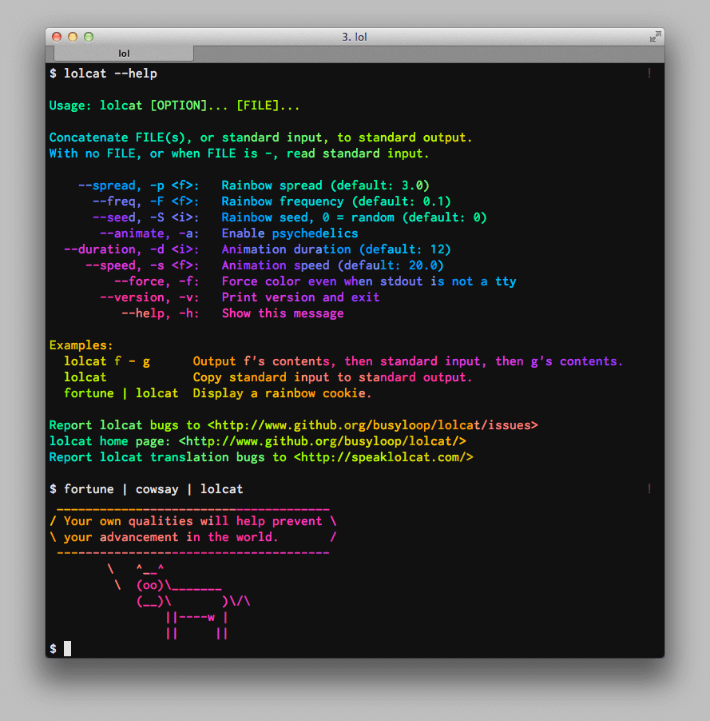

Slide 36
`sl | lolcat` on PE

Slide 37
Installing lolcat
C implementation: https://github.com/jaseg/lolcat
Just `make` and you will get `lolcat` on PE!

Slide 38
UNIT 22 EFFICIENCY
Recap. PS 22.1. PS 22.2

Slide 39
Recap
In CS1010, we will focus on the efficiency of your code in two senses:
First, your code should not perform redundant work and it should not repeat itself unnecessarily.
Second, your algorithm should run within a given Big-O running time.

Slide 40
UNIT 22 EFFICIENCY
PS 22.1. PS 22.2

Slide 41
Problem Set 22.1
Order the following functions in increasing rate of growth:
1. Log10 n 2. ln n
3. √n 4. n
5. n ln n 6. n^2
7. n ^ 4 8. 2^n
9. e^n 10. n!

Slide 42
How about when it is w.r.t Big-O?

Slide 43
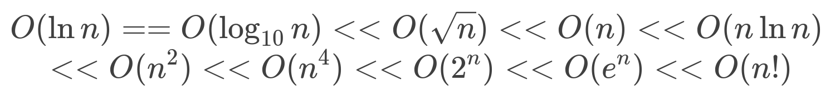
Problem Set 22.1
Notes:
The main thing here is that O(ln n) == O(log_10 n) because change of base is just constant factor.

Slide 44
UNIT 22 EFFICIENCY
Recap. PS 22.1. PS 22.2

Slide 45
Problem Set 22.2 a)
for (long i = 0; i < n; i += 1) { for (long j = 0; j < n; j += 2) { cs1010_println_long(i + j); } }
What is the Big-O running time of the following code, in terms of n?

Slide 46
Problem Set 22.2 a)
for (long i = 0; i < n; i += 1) { for (long j = 0; j < n; j += 2) { cs1010_println_long(i + j); } }
What is the Big-O running time of the following code, in terms of n? n^2

Slide 47
Problem Set 22.2 b)
for (long i = 0; i < n; i *= 2) { for (long j = 0; j < n; j *= 2) { cs1010_println_long(i + j); } }
What is the Big-O running time of the following code, in terms of n?

Slide 48
Problem Set 22.2 b)
for (long i = 0; i < n; i *= 2) { for (long j = 0; j < n; j *= 2) { cs1010_println_long(i + j); } }
What is the Big-O running time of the following code, in terms of n? It simply won’t terminate :P

Slide 49
Problem Set 22.2 b)
for (long i = 1; i < n; i *= 2) { for (long j = 1; j < n; j *= 2) { cs1010_println_long(i + j); } }
What is the Big-O running time of the following code, in terms of n?

Slide 50
Problem Set 22.2 b)
for (long i = 1; i < n; i *= 2) { for (long j = 1; j < n; j *= 2) { cs1010_println_long(i + j); } }
What is the Big-O running time of the following code, in terms of n? (log2 n)^2

Slide 51
Problem Set 22.2 c)
long k = 1; for (long j = 0; j < n; j += 1) { k *= 2; for (long i = 0; i < k; i += 1) { cs1010_println_long(i + j); } }
What is the Big-O running time of the following code, in terms of n?

Slide 52
Problem Set 22.2 c)
long k = 1; for (long j = 0; j < n; j += 1) { k *= 2; for (long i = 0; i < k; i += 1) { cs1010_println_long(i + j); } }
What is the Big-O running time of the following code, in terms of n? 2 ^ n

Slide 53
Text version solution
This one got detailed working and explanation
https://github.com/yxliang01/cs1010-fun-stuff/blob/master/tutorial/08/Tut08.pdf

Slide 54
Assignment 4

Slide 55

At 5:38AM
Still affecting my project(s) at the moment...

Slide 56
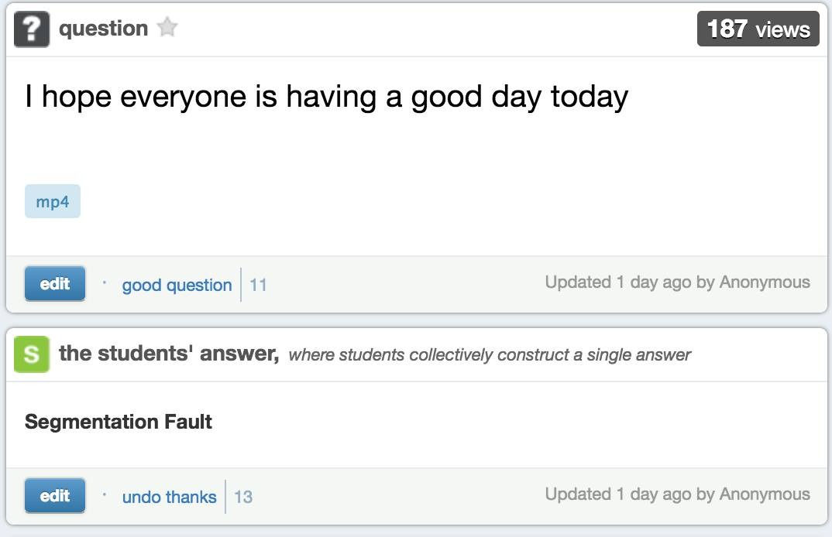

Slide 57
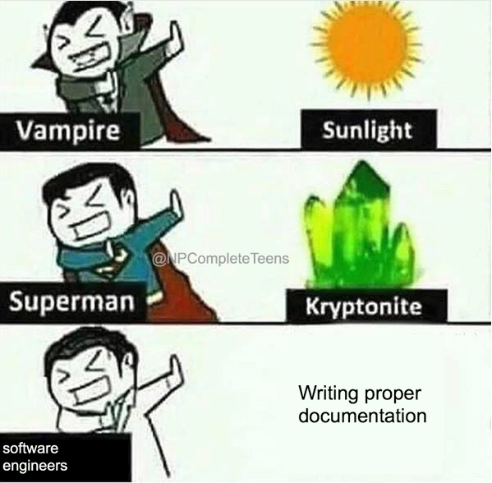

Slide 58
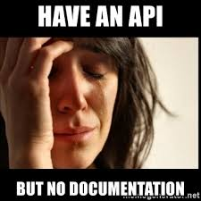

Slide 59
Assignment 5

Slide 60
Q & A

Slide 61
THE END
https://github.com/yxliang01/cs1010-fun-stuff/blob/master/tutorial-slides/tut08.pptx

Slide 62
PDF version at
https://github.com/yxliang01/cs1010-fun-stuff/blob/master/tutorial-slides/tut08.pdf

